Slide 1

E-Commerce Churn & Personalization Engine
A 5-week hands-on Big Data project built progressively in R across the core analytics lifecycle stages.

Slide 2
Course Project Strategy
Transforming modular lectures into one continuous enterprise data project developed week by week.

Slide 3


The Incremental Blueprint
Pedagogical Vision
Enterprise Scenario
Instead of isolated homework assignments, students build a single real-world system from raw logs to production. Each week adds a new layer to their R codebase.
Students act as Big Data Consultants for an e-commerce platform facing high customer drop-off. They ingest clickstreams, test hypotheses, build models, and deploy solutions.

Slide 4


Phase 1: Data Preparation
Ingest raw multi-source clickstream logs, order receipts, and user profiles.
Clean missing demographics and normalize purchase dollar amounts in R.
Deduplicate transaction records and isolate outlier buying behavior.
Engineer Recency, Frequency, and Monetary (RFM) customer feature tables.

Slide 5
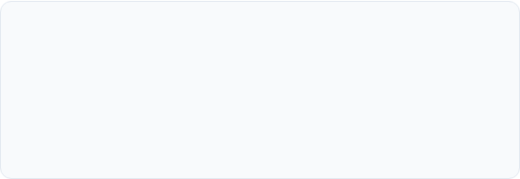
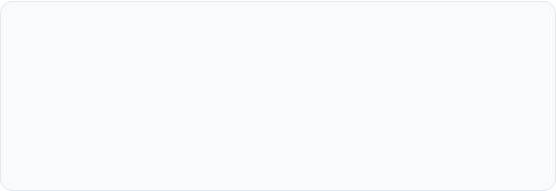
Phase 2: Model Planning
Hypothesis Formulation
Statistical Rigor in R
Formulate Null (H₀) and Alternative (H₁) hypotheses to test marketing claims (e.g., "Discount-only buyers churn 40% faster").
Execute t-tests, ANOVA, and Chi-Square tests to verify whether churn drivers are statistically significant vs. random sample variance.

Slide 6
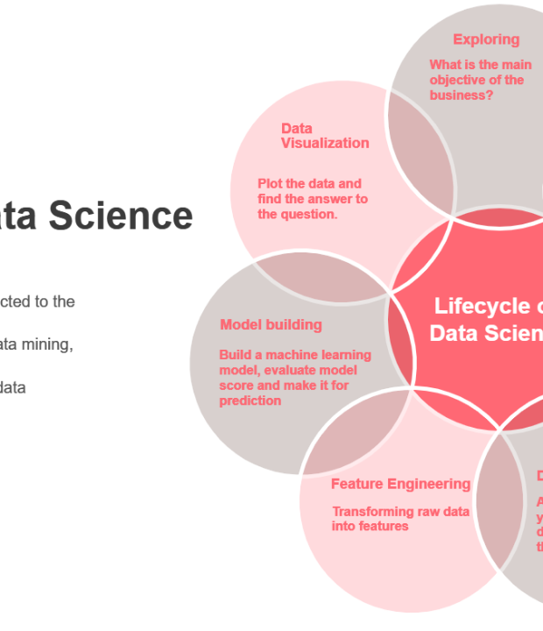
Phase 3: Model Building
Predictive Analytics in R
Train Logistic Regression (`glm`) and Random Forest models in R to calculate individual customer churn probability scores.
Perform diagnostic validation using confusion matrices, residual plots, ROC curves, and AUC evaluation metrics.

Slide 7

Phase 4: Results & Impact
Communicating to Stakeholders
$120k
Build an interactive R Shiny dashboard and ggplot2 graphics to present actionable insights directly to non-technical executives.
Demonstrate how flagging the top 5% at-risk customer segment prevents severe churn and recovers significant enterprise revenue.
Monthly Savings

Slide 8






Phase 5: Operationalizing
Distributed Engines
Stream Processing
PII & Security
Connect R scripts to Hadoop/HDFS, Hive, and Apache Spark for handling high-volume distributed logs.
Integrate models with Kafka and Spark Streaming to score live clickstreams in near real-time.
Implement static data masking and anonymization rules to protect sensitive user PII during production deployment.

Slide 9
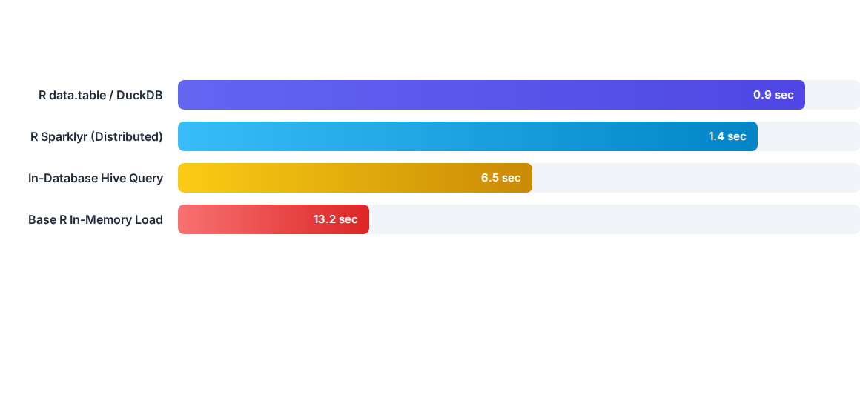
Model Speed Benchmarks
Students benchmark query execution speeds across modern R big data tools, observing how optimized packages process millions of records effortlessly.

Slide 10





5-Week Project Roadmap
Week 2
Week 4
Hypothesis Testing & EDA in R
Interactive R Shiny Dashboard
Week 1
Week 3
Week 5
Raw Data Prep & RFM Table Creation
Model Building & ROC Diagnostics
Spark Deployment & PII Security

Slide 11
Pedagogical Advantage
By connecting every lecture to one continuously evolving project, students graduate with an end-to-end Big Data codebase and a portfolio-ready enterprise system.
"
"
— Fundamentals of Big Data Curriculum Philosophy

Slide 12
Questions & Discussion
Ready to implement the Incremental Big Data Project Curriculum.

Slide 13


Image Sources
https://www.sloane-staffing.com/images/79ded7cd-1709234404591.jpg
Source: www.sloane-staffing.com
https://miro.medium.com/1*uq_GVCVhGRqzlj0kkO0X0g.png
Source: medium.com

